Slide 1
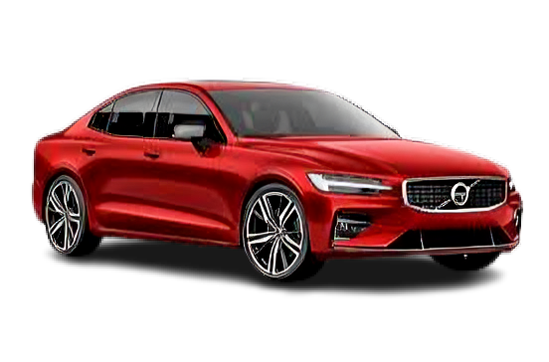

CAR PRICE PREDICTION USING MACHINE LEARNING LANGUAGE
Prepared by
P. Syam babu
Ch. Jeswanth Balaji
P. Manikanta Sai

Slide 2
Introduction
There are two ways to sell a car one is offline and the opposite being online. In offline transactions, there is a mediator found in among who's very at risk of being corrupt and make overly profitable transactions.
The second option is online in which there may be a certain platform which shall be the person find the price he might get if he is going for promoting. Kilometers traveled The number of kilometers travelled with the aid of an automobile has a massive function to play while putting the vehicle up on the market. The extra the automobile has travelled, the older it's miles. Fiscal energy It is the electricity output of the automobile. Year of registration It is the year when the vehicle was registered with the Road Transport Authority. More output yields higher price out of an automobile.
Predicting the price of used cars in both an important and interesting problem. According to data obtained from the National Transport Authority , the number of cars registered between 2003 and 2013 has witnessed a spectacular increase of 234%. From 68, 524 cars registered in 2003, this number has now reached 160, 701. With difficult economic conditions, it is likely that sales of second-hand imported (reconditioned) cars and used cars will increase. It is reported in that the sales of new cars has registered a decrease of 8% in 2013.

Slide 3
Objective of the Project
Data Collection: To scrape the data of at least 5000 used cars from various websites like Olx, car Dekho, cars24, auto portal, car trade, etc.
Model Building: To build a supervised machine learning model for forecasting the value of a vehicle based on multiple attributes.

Slide 4
Motivation
Marketplaces such as ebay.com, amazon.com or alibaba.com, want to gain more insights into customers’ willingness to pay and thus product pricing strategies. In these online marketplaces, products are usually presented by images, attributes in a tabular form and unstructured description texts. For example, marketplaces use these product data and combine it with user-interaction data to create recommendation systems.
At times, attributes of products are used to predict market prices. To know exact market prices is useful when dealing with more expensive products that require a high investment, such as cars or houses. Online car markets provide a platform where sellers can present their cars also by images, structured attributes and texts. Due to the individuality of cars it is even difficult for car experts to predict an accurate market price. To overcome this challenge and to help prospective buyers, online car markets, such as mobile and cars, apply pricing models to provide neutral market price estimates. These pricing models predict car market prices based on cars‘ structured attributes that were set by the seller. Because car prices often depend on cars‘ individual conditions and configuration, sellers add user-generated vehicle description texts to provide additional information about them. For better price differentiation, these texts are an important information source to provide more price transparency and price distinctiveness.

Slide 5
Literature Review
We did a background survey regarding the basic ideas of our project and used those
ideas for the collection of information like the technological
stack, algorithms, and shortcomings of our project which led
us to build a better project.
CARS24
Cars24 is a web platform where seller can sell their used car.
It is an Indian Start-up with a simplified user interface which
asks seller parameters like car model, kilometers traveled,
year of registration and vehicle type (petrol, diesel)[1]. These
allow the web model to run certain algorithms on given
parameters and predict the price.

Slide 6
GET VEHICLE PRICE
Get Vehicle Price is an android app which works on similar parameters as of Cars24. This app predicts vehicle prices on various parameter like Fiscal power, horsepower, kilometers traveled. This app uses a machine learning approach to predict the price of a car, bike, electric vehicle and hybrid vehicle. This app can predict the price of any vehicle because of the smartly optimized algorithm.
CARTRADE
CarTrade is web and Android platform where user can research New Cars in India by exploring Car Prices, Car Specs, Images, Mileage, Reviews, and Car Comparisons. On this app one can Sell Used Car to genuine buyers with ease. One can list their used car for sale along with the details like
image, model, and year of purchase and kilometers so that it is displayed to lakhs of interested car buyers in their city. User can read user reviews and expert car reviews with images that help in finalizing a new car buying decision.

Slide 7
Keywords and definitions
Data understanding and exploration
Data cleaning
Data preparation
Model building and evaluation

Slide 8
Data understanding and exploration:
The first step in data analysis involving the use of data visualization tools and statistical techniques to uncover data set characteristics and initial patterns.
Data cleaning:
The process of preparing data for analysis by removing or modifying data that is incorrect, incomplete, irrelevant, duplicated, or improperly formatted.
Data preparation:
The process of gathering, combining, structuring and organizing data
Model building and evaluation:
This technique of Evaluation helps us to know which algorithm best suits the given dataset for solving a particular problem. Likewise, in terms of Machine Learning it is called as “Best Fit”.

Slide 9
It is considered to be a key factor in determining the price of used cars. A sample of the collected data is shown in below.
Company | Cylinder Volume (CC) | Year | MILEAGE / KM | Price (Rs.)
TOYOTA | 1300 | 2007 | 38,000 | 4,10,000
NISSAN | 1500 | 2007 | 50,000 | 3,25,000
HONDA | 1500 | 2005 | 59,000 | 3,85,000
TOYOTA | 1000 | 2007 | 59,000 | 3,60,000
TOYOTA | 1300 | 1989 | 62,665 | 50,000
TOYOTA | 1500 | 2008 | 67,000 | 6,15,000
TOYOTA | 1600 | 2006 | 82,000 | 5,50,000

Slide 10
Methodologies
In this section, we discuss various algorithms and the required dataset that were implemented to build this module.
Linear Regression :
Quick to train and test as a baseline algorithm
Random Forest:
It uses a model called decision tree, multiple decision trees to generate the ensemble model which collectively produces a prediction.
Gradient Boost :
A method of transforming weak learners into strong learners. This model was chosen to account for non-linear relationships between the features and predicted price, by splitting the data into 100 regions.

Slide 11
XGBoost:
Extreme Gradient Boosting or XGBoost significantly improve the performance such as built in support for regularization, parallel processing as well as giving additional hyperparameters to tune such as tree pruning, sub sampling and number of decision trees.
LightGBM:
LightGBM has a leaf-wise tree growth instead of a level-wise approach resulting in higher loss reduction and reducing memory usage.
KMeans + Linear Regression:
K-means clustering as the name itself suggests, is a clustering algorithm, with no pre determined labels defined
Deep Neural Network (MLP Regressor):
The MLP regressor, which uses a deep neural net perceptron regressor model. This model optimizes the squared-loss using stochastic gradient descent.

Slide 12
Challenges faced
Poor Quality of Data
Slow Implementation
Obtaining Data
Errors while running

Slide 13
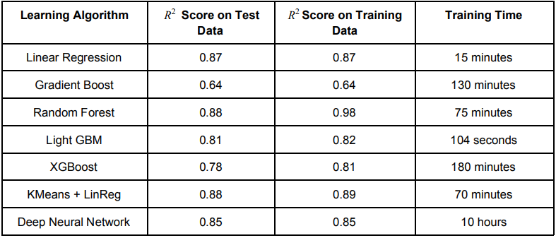
Results
The results of our tests were quantified in terms of the R score of our predictions. score is a statistical 2 R 2 measure of how close the data are to the fitted regression line.

Slide 14
Compared to Linear Regression, most Decision-Tree based methods did not perform comparably well.
The difficulty in tuning the hyperparameters for most gradient boost methods.
Random Forest method which marginally outperforms Linear Regression. However Random Forests tend to overfit the dataset due to the tendency of growing longer trees.
As expected lightGBM performed marginally better than XGBoost but had a significantly faster training time in Linear Regression.
The deep neural network was converging to local minima due to small batch-sizes.
Building up from the relatively good performance of Linear Regression, the KMeans + Linear Regression Ensemble Learning Method produced the best R score on test data without high variance as it fits linear relationships categorically.

Slide 15
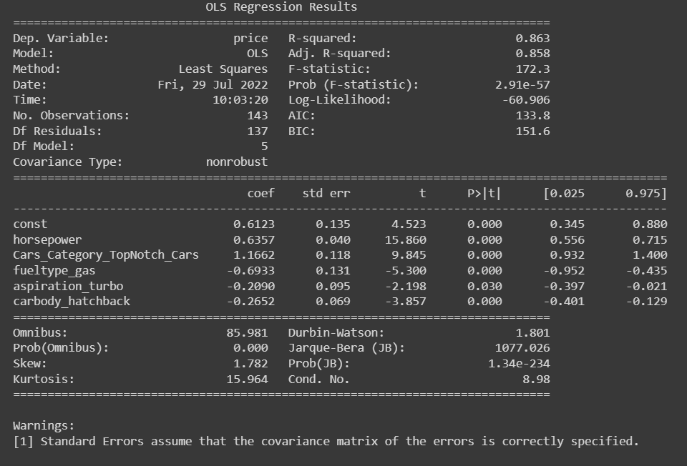
Result

Slide 16
Conclusion
By performing different ML models, we aim to get a better result or less error with max accuracy. Our purpose was to predict the price of the used cars.
Here, we can see that all the predicted prices are either equal or nearly equal to the original prices of the car.
Hence we conclude that our model ‘price car’ is working very well.

Slide 17
Future Scope
We may add large historical data of car price which can help to improve accuracy of the machine learning model. For better performance, we plan to judiciously design deep learning network structures, use adaptive learning rates and train on clusters of data rather than the whole dataset

Slide 18
references
https://www.kaggle.com/datasets/hellbuoy/car-price-prediction/code
https://suhas-maddali007.medium.com/predicting-car-prices-using-machine-learning-and-data-science-52ed44abab1b
N. Monburinon, P. Chertchom, T. Kaewkiriya, S. Rungpheung, S. Buya and P. Boonpou, "Prediction of prices for used car by using regression models," 2018 5th International Conference on Business and Industrial Research (ICBIR), Bangkok, 2018, pp. 115-119.
Listiani M. 2009. Support Vector Regression Analysis for Price Prediction in a Car Leasing Application. Master Thesis. Hamburg University of Technology 4. Chen, Tianqi, and Carlos Guestrin. "Xgboost: A scalable tree boosting system." Proceedings of the 22nd acm sigkdd international conference on knowledge discovery and data mining. ACM, 2016.
Ke, Guolin, et al. "Lightgbm: A highly efficient gradient boosting decision tree." Advances in Neural Information Processing Systems. 2017
Fisher, Walter D. "On grouping for maximum homogeneity." Journal of the American statistical Association 53.284 (1958): 789-798.
https://scikit-learn.org/stable/modules/classes.html: Scikit-learn: Machine Learning in Python, Pedregosa et al., JMLR 12, pp. 2825-2830, 2011.

